Slide 1

Application Layer Part 5
Mark Allman
Case / ICSI
EECS 325/425
Fall 2018
“Well, beat the drum and hold the phone, The sun came out today,
We're born again, there's new grass on the field”

Slide 2
Many of these slides are more-or-less directly from the slide set developed by Jim Kurose and Keith Ross for their book “Computer Networking: A Top Down Approach, 5th edition”.
The slides have been lightly adapted for Mark Allman’s EECS 325/425 Computer Networks class at Case Western Reserve University.
All material copyright 1996-2010
J.F Kurose and K.W. Ross, All Rights Reserved
Allman

Slide 3
An Aside on Protocols …
Allman
3

Slide 4
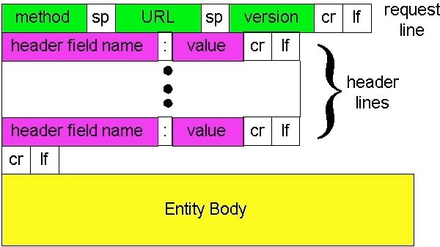
An Aside on Protocols …
We have been examining HTTP …
We learned this is the general form of an HTTP request …
Allman
3

Slide 5
An Aside on Protocols …
We have been examining HTTP …
We learned this is the general form of an HTTP request …
Why?!
Allman
3

Slide 6
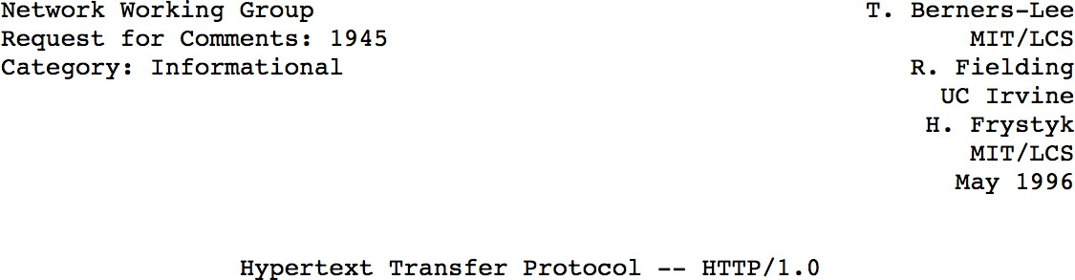
Original HTTP Specification
Allman

Slide 7

Standards
Internet Engineering Task Force
Allman

Slide 8
IETF
Develops Internet standards
Meets three times / year
Mostly does work on mailing lists
Open …. anyone can “join”!
… as an individual
Split into working groups based on technology
e.g., DNS,TCP, IPv6, …
Allman

Slide 9
IETF
Specifications written in “Request For Comments” (RFCs)
name is historic
Not all RFCs are standards (or specifications)
some experimental
some informational
etc.
Allman

Slide 10
RFCs
Allman
8

Slide 11
RFCs
Over 8,400 RFCs published
1st: April 1969
Last: September 6, 2018
Allman
8

Slide 12
RFCs
Over 8,400 RFCs published
1st: April 1969
Last: September 6, 2018
(be wary of RFCs dated April 1!)
Allman
8

Slide 13
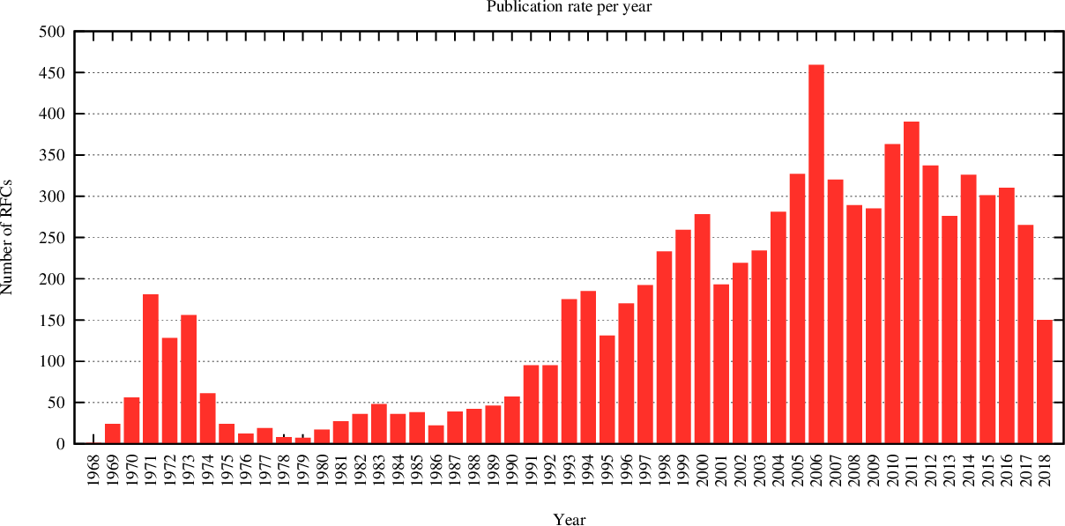
RFCs
Allman
https://www.arkko.com/tools/docstats.html
9

Slide 14
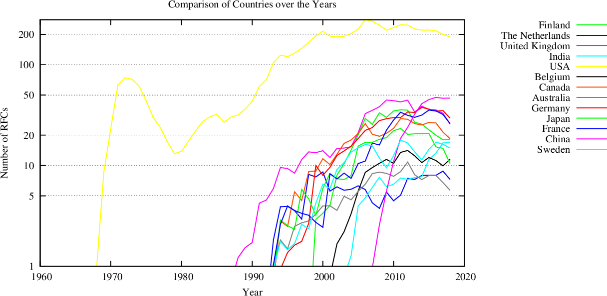
RFCs
Allman
https://www.arkko.com/tools/docstats.html
10

Slide 15
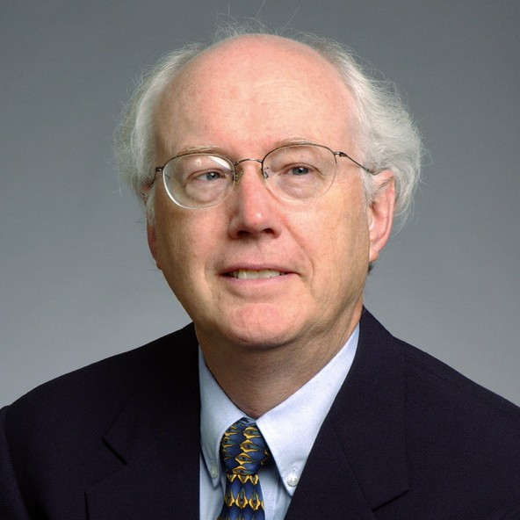
IETF
Allman
11

Slide 16
IETF
“We reject kings, presidents and voting. We believe in rough consensus and running code.”
—David Clark
Allman
11

Slide 17
Consensus
WGs and the broader IETF have a variety of ways to assess consensus
One is to get the “sense of the room” at in- person meetings
Allman
12

Slide 18
Beyond Basic HTTP
HTTP is a big protocol / ecosystem with many extensions and variants
One more example extension …
Allman
13

Slide 19
HTTP state
Application 2-23

Slide 20
HTTP state
HTTP is “stateless”
 server maintains no information about past client requests
Application 2-23

Slide 21
HTTP state
HTTP is “stateless”
 server maintains no information about past client requests
protocols that maintain “state” are complex!
Application 2-23

Slide 22
HTTP state
HTTP is “stateless”
server maintains no information about past client requests
protocols that maintain “state” are complex!
past history (state) must be maintained
if server/client crashes, their views of “state” may be inconsistent, must be reconciled
Application 2-23

Slide 23
Application 2-36

Slide 24
User-server state: cookies
Application 2-36

Slide 25
User-server state: cookies
many Web sites use cookies
four components:
cookie header line of HTTP response message
cookie header line in HTTP request message
cookie file kept on user’s host, managed by user’s browser
back-end database at Web site
Application 2-36

Slide 26
User-server state: cookies
example:
Susan always access Internet from PC
visits specific e- commerce site for first time
when initial HTTP request arrives at site, site creates:
unique ID
entry in backend database for ID
many Web sites use cookies
four components:
cookie header line of HTTP response message
cookie header line in HTTP request message
cookie file kept on user’s host, managed by user’s browser
back-end database at Web site
Application 2-36

Slide 27
Cookies: keeping “state” (cont.)
client
Amazon server
ebay 8734
cookie file
backend database
Application 2-37

Slide 28
Cookies: keeping “state” (cont.)
client
Amazon server
Amazon server creates ID
ebay 8734
usual http request msg
1678 for user ^{create}
entry
backend database
Application 2-37

Slide 29
Cookies: keeping “state” (cont.)
client
Amazon server
Amazon server creates ID
ebay 8734
usual http request msg
usual http response
Set-cookie: 1678
ebay 8734
amazon 1678
1678 for user ^{create}
entry
backend database
Application 2-37

Slide 30
Cookies: keeping “state” (cont.)
client
Amazon server
Amazon server creates ID
ebay 8734
usual http request msg
usual http response
Set-cookie: 1678
ebay 8734
amazon 1678
1678 for user ^{create}
entry
usual http request msg
cookie: 1678
cookie- specific action
access
usual http response msg
backend database
Application 2-37

Slide 31
Cookies: keeping “state” (cont.)
client
Amazon server
Amazon server creates ID
ebay 8734
usual http request msg
usual http response
Set-cookie: 1678
ebay 8734
amazon 1678
1678 for user ^{create}
entry
usual http request msg
cookie: 1678
cookie- specific action
access
one week later:
usual http response msg
backend database
ebay 8734
amazon 1678
Application 2-37

Slide 32
Cookies: keeping “state” (cont.)
client
Amazon server
Amazon server creates ID
ebay 8734
usual http request msg
usual http response
Set-cookie: 1678
ebay 8734
amazon 1678
1678 for user ^{create}
entry
usual http request msg
cookie: 1678
cookie- specific action
access
one week later:
usual http response msg
backend database
access
ebay 8734
amazon 1678
usual http request msg
cookie: 1678
cookie- specific action
usual http response msg
Application 2-37

Slide 33
Cookies (continued)
Application 2-38

Slide 34
Cookies (continued)
what cookies can bring:
authorization
shopping carts
recommendations
user session state (Web e-mail)
Application 2-38

Slide 35
Cookies (continued)
what cookies can bring:
authorization
shopping carts
recommendations
user session state (Web e-mail)
how to keep “state”:
 protocol endpoints: maintain state at sender/receiver over multiple transactions
 cookies: http messages carry state
Application 2-38

Slide 36
Cookies (continued)
what cookies can bring:
authorization
shopping carts
recommendations
user session state (Web e-mail)
aside
cookies and privacy:
cookies permit sites to learn a lot about you
e..g., you may supply name and e-mail to sites
how to keep “state”:
 protocol endpoints: maintain state at sender/receiver over multiple transactions
 cookies: http messages carry state
Application 2-38

Slide 37

Reading Along ...
2.4: Email
Allman
18

Slide 38
Electronic Mail
Application 2-50

Slide 39
Electronic Mail
Three major components:
Application 2-50

Slide 40
Electronic Mail
Three major components:
 mail servers (MTA)
mail server
mail server
mail server
Application 2-50

Slide 41
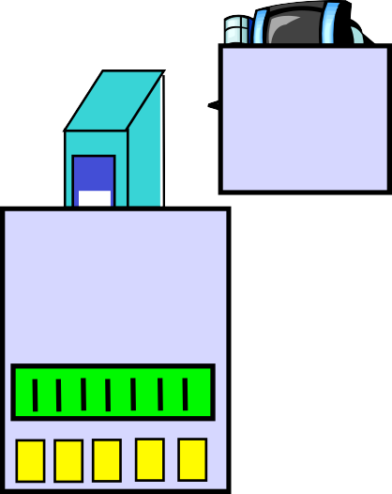
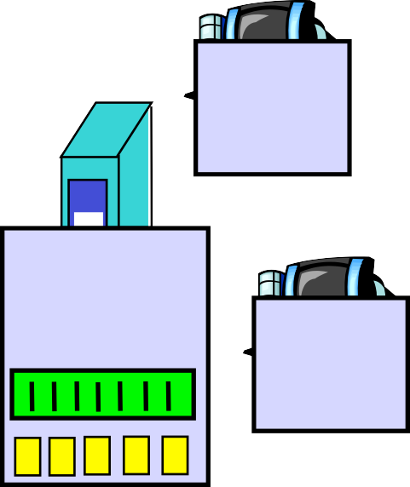



Electronic Mail
Three major components:
mail servers (MTA)
user agents (MUA)
user agent
mail server
user agent
mail server
user agent
mail
user agent
server
user agent
user agent
Application 2-50

Slide 42
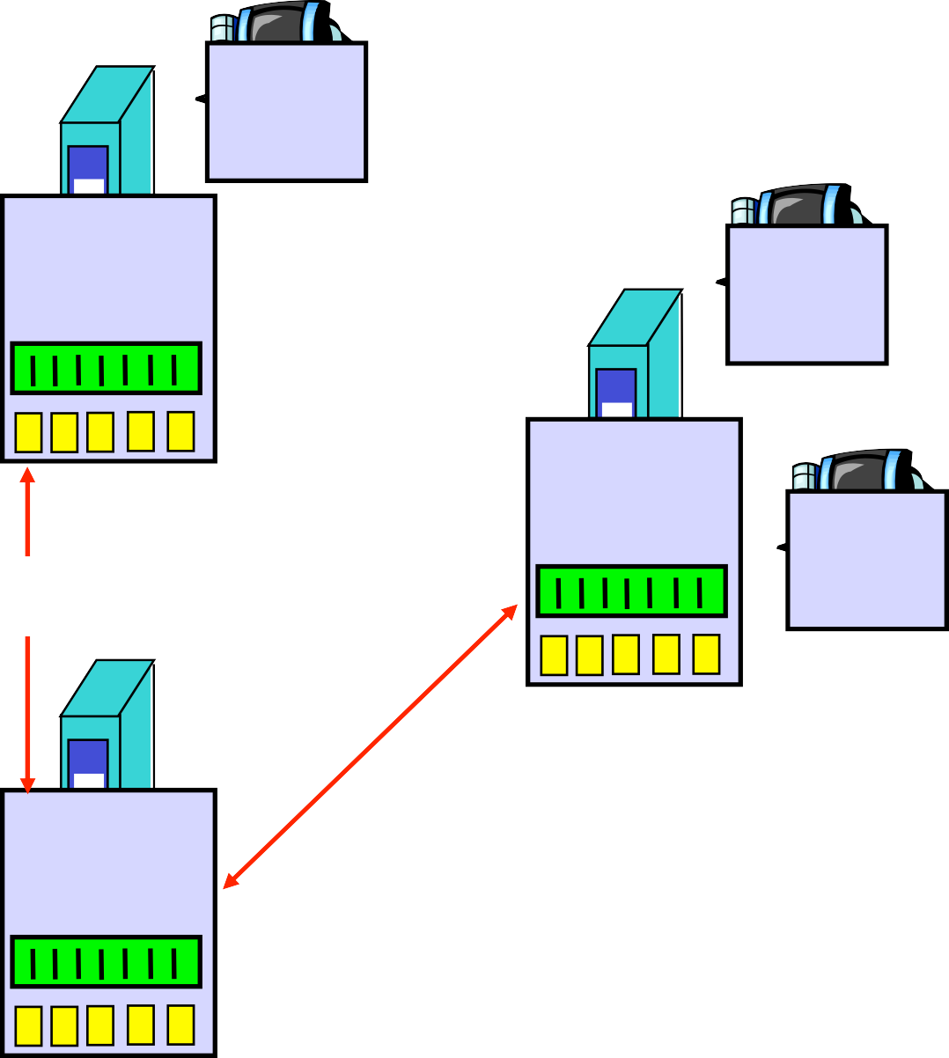
Electronic Mail
Three major components:
mail servers (MTA)
user agents (MUA)
simple mail transfer protocol: SMTP
user agent
mail server
user agent
SMTP
mail server
user agent
SMTP
SMTP
mail server
user agent
user agent
user agent
Application 2-50

Slide 43
Electronic Mail
outgoing
message queue
user mailbox
Three major components:
mail servers (MTA)
user agents (MUA)
simple mail transfer protocol: SMTP
user agent
mail server
user agent
SMTP
mail server
User Agent
a.k.a. “mail reader”
composing, editing, reading mail messages
e.g., Outlook, elm, Mozilla Thunderbird, iPhone mail client, web mail
outgoing, incoming messages stored on server
user agent
SMTP
SMTP
mail server
user agent
user agent
user agent
Application 2-50

Slide 44




Electronic Mail: mail servers
user agent
mail server
user agent
SMTP
mail server
user agent
SMTP
SMTP
mail server
user agent
user agent
user agent
Application 2-51

Slide 45
Electronic Mail: mail servers
Mail Servers
user agent
mail server
user agent
SMTP
mail server
user agent
SMTP
SMTP
mail server
user agent
user agent
user agent
Application 2-51

Slide 46
Electronic Mail: mail servers
Mail Servers
 mailbox contains incoming messages for user
user agent
mail server
user agent
SMTP
mail server
user agent
SMTP
SMTP
mail server
user agent
user agent
user agent
Application 2-51

Slide 47
Electronic Mail: mail servers
Mail Servers
mailbox contains incoming messages for user
message queue of outgoing (to be sent) mail messages
user agent
mail server
user agent
SMTP
mail server
user agent
SMTP
SMTP
mail server
user agent
user agent
user agent
Application 2-51

Slide 48
Electronic Mail: mail servers
Mail Servers
mailbox contains incoming messages for user
message queue of outgoing (to be sent) mail messages
SMTP protocol between mail servers to send email messages
 client: sending mail server
user agent
mail server
user agent
SMTP
mail server
user agent
SMTP
SMTP
mail server
user agent

server: receiving mail server
user agent
user agent
Application 2-51

Slide 49
Electronic Mail: SMTP [RFC 2821]
Application 2-52

Slide 50
Electronic Mail: SMTP [RFC 2821]
 uses TCP to transfer email message from client to server, port 25
Application 2-52

Slide 51
Electronic Mail: SMTP [RFC 2821]
uses TCP to transfer email message from client to server, port 25
direct transfer: sending server to receiving server
Application 2-52

Slide 52
Electronic Mail: SMTP [RFC 2821]
uses TCP to transfer email message from client to server, port 25
direct transfer: sending server to receiving server
three phases of transfer
handshaking (greeting)
transfer of messages
closure
Application 2-52

Slide 53
Electronic Mail: SMTP [RFC 2821]
uses TCP to transfer email message from client to server, port 25
direct transfer: sending server to receiving server
three phases of transfer
handshaking (greeting)
transfer of messages
closure
command/response interaction
commands: ASCII text
response: status code and phrase
Application 2-52

Slide 54




Scenario: Alice sends message to Bob
mail
mail
user agent
user agent
server
server
Application 2-53

Slide 55
Scenario: Alice sends message to Bob
1) Alice uses UA to compose message “to”
bob@someschool.edu
1
user agent
mail
mail
server
user agent
server
Application 2-53

Slide 56
Scenario: Alice sends message to Bob
Alice uses UA to compose message “to”
bob@someschool.edu
Alice’s UA sends message to her mail server; message placed in message queue
1
user agent
mail
mail
server
user agent
server
2
Application 2-53

Slide 57
Scenario: Alice sends message to Bob
Alice uses UA to compose message “to”
bob@someschool.edu
Alice’s UA sends message to her mail server; message placed in message queue
Client side of SMTP opens TCP connection with Bob’s mail server
1
user agent
mail
mail
server
user agent
server
2
3
Application 2-53

Slide 58
Scenario: Alice sends message to Bob
Alice uses UA to compose message “to”
bob@someschool.edu
Alice’s UA sends message to her mail server; message placed in message queue
Client side of SMTP opens TCP connection with Bob’s mail server
4) SMTP client sends Alice’s message over the TCP connection
1
user agent
mail
mail
server
user agent
server
2
3
4
Application 2-53

Slide 59
Scenario: Alice sends message to Bob
Alice uses UA to compose message “to”
bob@someschool.edu
Alice’s UA sends message to her mail server; message placed in message queue
Client side of SMTP opens TCP connection with Bob’s mail server
SMTP client sends Alice’s message over the TCP connection
Bob’s mail server places the message in Bob’s mailbox
1
user agent
mail
mail
server
user agent
server
2
3
4
5
Application 2-53

Slide 60
Scenario: Alice sends message to Bob
Alice uses UA to compose message “to”
bob@someschool.edu
Alice’s UA sends message to her mail server; message placed in message queue
Client side of SMTP opens TCP connection with Bob’s mail server
SMTP client sends Alice’s message over the TCP connection
Bob’s mail server places the message in Bob’s mailbox
Bob invokes his user agent to read message
1
user agent
mail
mail
server
user agent
server
2
3
6
4
5
Application 2-53

Slide 61
Sample SMTP interaction
Application 2-54

Slide 62
Sample SMTP interaction
S: 220 hamburger.edu
Application 2-54

Slide 63
Sample SMTP interaction
S: 220 hamburger.edu C: HELO crepes.fr
Application 2-54

Slide 64
Sample SMTP interaction
S: 220 hamburger.edu C: HELO crepes.fr
S: 250 Hello crepes.fr, pleased to meet you
Application 2-54

Slide 65
Sample SMTP interaction
S: 220 hamburger.edu C: HELO crepes.fr
S: 250 Hello crepes.fr, pleased to meet you C: MAIL FROM: <alice@crepes.fr>
Application 2-54

Slide 66
Sample SMTP interaction
S: | 220 hamburger.edu
C: | HELO crepes.fr
S: | 250 Hello crepes.fr, pleased | to meet you
C: | MAIL FROM: <alice@crepes.fr>
S: | 250 alice@crepes.fr... Sender | ok
Application 2-54

Slide 67
Sample SMTP interaction
S: | 220 hamburger.edu
C: | HELO crepes.fr
S: | 250 Hello crepes.fr, pleased | to meet you
C: | MAIL FROM: <alice@crepes.fr>
S: | 250 alice@crepes.fr... Sender | ok
C: | RCPT TO: <bob@hamburger.edu>
Application 2-54

Slide 68
Sample SMTP interaction
S: | 220 hamburger.edu
C: | HELO crepes.fr
S: | 250 Hello crepes.fr, pleased | to meet you
C: | MAIL FROM: <alice@crepes.fr>
S: | 250 alice@crepes.fr... Sender | ok
C: | RCPT TO: <bob@hamburger.edu>
S: 250 bob@hamburger.edu ... Recipient ok
Application 2-54

Slide 69
Sample SMTP interaction
S: C: S: C: S: | 220 hamburger.edu HELO crepes.fr 250 Hello crepes.fr, pleased MAIL FROM: <alice@crepes.fr> 250 alice@crepes.fr... Sender | to meet you ok
C: S: C: | RCPT TO: <bob@hamburger.edu> 250 bob@hamburger.edu ... Recipient DATA |  | ok
Application 2-54

Slide 70
Sample SMTP interaction
S: 220 hamburger.edu C: HELO crepes.fr
S: 250 Hello crepes.fr, pleased to meet you C: MAIL FROM: <alice@crepes.fr>
S: 250 alice@crepes.fr... Sender ok C: RCPT TO: <bob@hamburger.edu>
S: 250 bob@hamburger.edu ... Recipient ok C: DATA
S: 354 Enter mail, end with "." on a line by itself
Application 2-54

Slide 71
Sample SMTP interaction
S: | 220 hamburger.edu
C: | HELO crepes.fr
S: | 250 Hello crepes.fr, pleased | to meet you
C: | MAIL FROM: <alice@crepes.fr>
S: | 250 alice@crepes.fr... Sender | ok
C: | RCPT TO: <bob@hamburger.edu>
S: 250 bob@hamburger.edu ... Recipient ok C: DATA
S: 354 Enter mail, end with "." on a line by itself C: Do you like ketchup?
C: How about pickles? C: .
Application 2-54

Slide 72
Sample SMTP interaction
S: | 220 hamburger.edu
C: | HELO crepes.fr
S: | 250 Hello crepes.fr, pleased | to meet you
C: | MAIL FROM: <alice@crepes.fr>
S: | 250 alice@crepes.fr... Sender | ok
C: | RCPT TO: <bob@hamburger.edu>
S: 250 bob@hamburger.edu ... Recipient ok C: DATA
S: 354 Enter mail, end with "." on a line by itself C: Do you like ketchup?
C: How about pickles? C: .
S: 250 Message accepted for delivery
Application 2-54

Slide 73
Sample SMTP interaction
S: | 220 hamburger.edu
C: | HELO crepes.fr
S: | 250 Hello crepes.fr, pleased | to meet you
C: | MAIL FROM: <alice@crepes.fr>
S: | 250 alice@crepes.fr... Sender | ok
C: | RCPT TO: <bob@hamburger.edu>
S: 250 bob@hamburger.edu ... Recipient ok C: DATA
S: 354 Enter mail, end with "." on a line by itself C: Do you like ketchup?
C: How about pickles? C: .
S: | 250 | Message | accepted | for | delivery
C: | QUIT
Application 2-54

Slide 74
Sample SMTP interaction
S: | 220 hamburger.edu
C: | HELO crepes.fr
S: | 250 Hello crepes.fr, pleased | to meet you
C: | MAIL FROM: <alice@crepes.fr>
S: | 250 alice@crepes.fr... Sender | ok
C: | RCPT TO: <bob@hamburger.edu>
S: 250 bob@hamburger.edu ... Recipient ok C: DATA
S: 354 Enter mail, end with "." on a line by itself C: Do you like ketchup?
C: How about pickles? C: .
S: 250 Message accepted for delivery C: QUIT
S: 221 hamburger.edu closing connection
Application 2-54

Slide 75
Sample SMTP interaction
S: | 220 hamburger.edu
C: | HELO crepes.fr
S: | 250 Hello crepes.fr, pleased | to meet you
C: | MAIL FROM: <alice@crepes.fr>
S: | 250 alice@crepes.fr... Sender | ok
C: | RCPT TO: <bob@hamburger.edu>
S: 250 bob@hamburger.edu ... Recipient ok C: DATA
S: 354 Enter mail, end with "." on a line by itself C: Do you like ketchup?
C: How about pickles? C: .
S: 250 Message accepted for delivery C: QUIT
S: 221 hamburger.edu closing connection
Application 2-54

Slide 76
Sample SMTP interaction
S: | 220 hamburger.edu
C: | HELO crepes.fr
S: | 250 Hello crepes.fr, pleased | to meet you
C: | MAIL FROM: <alice@crepes.fr>
S: | 250 alice@crepes.fr... Sender | ok
C: | RCPT TO: <bob@hamburger.edu>
S: 250 bob@hamburger.edu ... Recipient ok C: DATA
S: 354 Enter mail, end with "." on a line by itself C: Do you like ketchup?
C: How about pickles? C: .
S: 250 Message accepted for delivery C: QUIT
S: 221 hamburger.edu closing connection
Application 2-54

Slide 77
Try SMTP interaction for yourself:
telnet servername 25
see 220 reply from server
enter HELO, MAIL FROM, RCPT TO, DATA, QUIT
commands
above lets you send email without using email client (reader)
Application 2-55

Slide 78
Mail message format
SMTP: protocol for exchanging email msgs
RFC 822: standard for text message format:
header lines, e.g.,
To:
From:
Subject:
different from SMTP commands!
body
the “message”
header
blank line
body
Application 2-57

Slide 79


Refining Mail Delivery
user agent
user agent
sender’s mail server
receiver’s mail server
Application 2-58

Slide 80
Refining Mail Delivery
SMTP
user agent
user agent
sender’s mail server
receiver’s mail server
 SMTP: delivery/storage to receiver’s server
Application 2-58

Slide 81
Refining Mail Delivery
SMTP
access
user agent
user agent
protocol
sender’s mail server
receiver’s mail server
SMTP: delivery/storage to receiver’s server
mail access protocol: retrieval from server
Application 2-58

Slide 82
Refining Mail Delivery
SMTP
access
user agent
user agent
protocol
sender’s mail server
receiver’s mail server
SMTP: delivery/storage to receiver’s server
mail access protocol: retrieval from server
POP: Post Office Protocol [RFC 1939]
authorization (agent <-->server) and download
Application 2-58

Slide 83
Refining Mail Delivery
SMTP
access
user agent
user agent
protocol
sender’s mail server
receiver’s mail server
SMTP: delivery/storage to receiver’s server
mail access protocol: retrieval from server
POP: Post Office Protocol [RFC 1939]
authorization (agent <-->server) and download
IMAP: Internet Mail Access Protocol [RFC 1730]
more features (more complex)
manipulation of stored msgs on server
Application 2-58

Slide 84
Refining Mail Delivery
SMTP
access
user agent
user agent
protocol
sender’s mail server
receiver’s mail server
SMTP: delivery/storage to receiver’s server
mail access protocol: retrieval from server
POP: Post Office Protocol [RFC 1939]
authorization (agent <-->server) and download
IMAP: Internet Mail Access Protocol [RFC 1730]
more features (more complex)
manipulation of stored msgs on server
HTTP: gmail, Hotmail, Yahoo! Mail, etc.
Application 2-58

Slide 85
Refining Mail Delivery
SMTP SMTP
access
user agent
user agent
protocol
sender’s mail server
receiver’s mail server
SMTP: delivery/storage to receiver’s server
mail access protocol: retrieval from server
POP: Post Office Protocol [RFC 1939]
authorization (agent <-->server) and download
IMAP: Internet Mail Access Protocol [RFC 1730]
more features (more complex)
manipulation of stored msgs on server
HTTP: gmail, Hotmail, Yahoo! Mail, etc.
Application 2-58

Slide 86
POP3 protocol
Application 2-59

Slide 87
POP3 protocol
authorization phase
client commands:
user: declare username
pass: password
server responses
 +OK
-ERR
Application 2-59

Slide 88
POP3 protocol
S: +OK POP3 server ready C: user bob
S: +OK
C: pass hungry
S: +OK user successfully logged on
authorization phase
client commands:
user: declare username
pass: password
server responses
 +OK
-ERR
Application 2-59

Slide 89
POP3 protocol
S: +OK POP3 server ready C: user bob
S: +OK
C: pass hungry
S: +OK user successfully logged on
authorization phase
client commands:
user: declare username
pass: password
server responses
 +OK
-ERR
transaction phase, client:
list: list message numbers
retr: retrieve message by number
dele: delete
quit
Application 2-59

Slide 90
POP3 protocol
S: +OK POP3 server ready C: user bob
S: +OK
C: pass hungry
S: +OK user successfully logged on
C: list S: 1 498
S: 2 912
S: .
C: retr 1
S: <message 1 contents> S: .
C: dele 1
C: retr 2
S: <message 1 contents> S: .
C: dele 2 C: quit
S: +OK POP3 server signing off
authorization phase
client commands:
user: declare username
pass: password
server responses
 +OK
-ERR
transaction phase, client:
list: list message numbers
retr: retrieve message by number
dele: delete
quit
Application 2-59

Slide 91
POP3 (more) and IMAP
more about POP3
previous example uses “download and delete” mode.
Bob cannot re-read e-mail if he changes client
“download-and-keep”: copies of messages on different clients
POP3 is stateless across sessions
Application 2-60

Slide 92
POP3 (more) and IMAP
more about POP3
previous example uses “download and delete” mode.
Bob cannot re-read e-mail if he changes client
“download-and-keep”: copies of messages on different clients
POP3 is stateless across sessions
IMAP
keeps all messages in one place: at server
allows user to organize messages in folders
keeps user state across sessions:
 names of folders and mappings between message IDs and folder name
more complex!
Application 2-60

Slide 93
Reading Along ...
2.5 P2P Applications
Allman
30

Slide 94









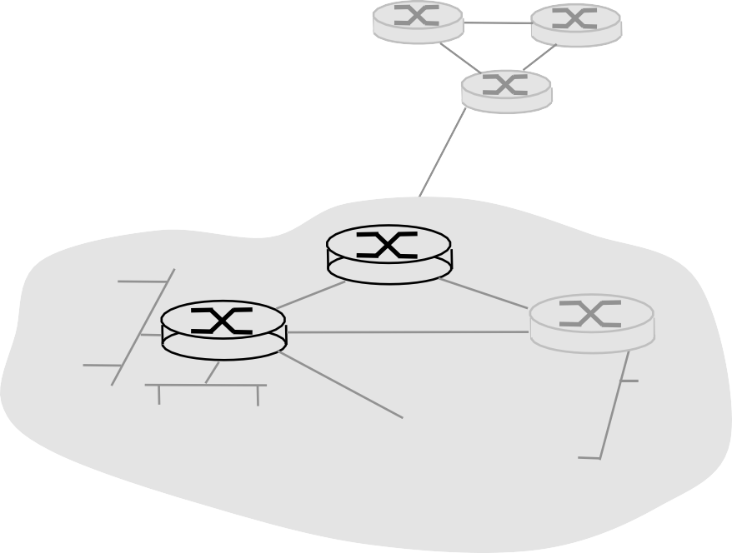







Pure P2P architecture
no always-on server
arbitrary end systems directly communicate
peers are intermittently connected and change IP addresses
Three topics:
file distribution
searching for information
case Study: Skype
Application 2-76

Slide 95


Pure P2P architecture
no always-on server
arbitrary end systems directly communicate
peers are intermittently connected and change IP addresses
peer-peer
Three topics:
file distribution
searching for information
case Study: Skype
Application 2-76

Slide 96
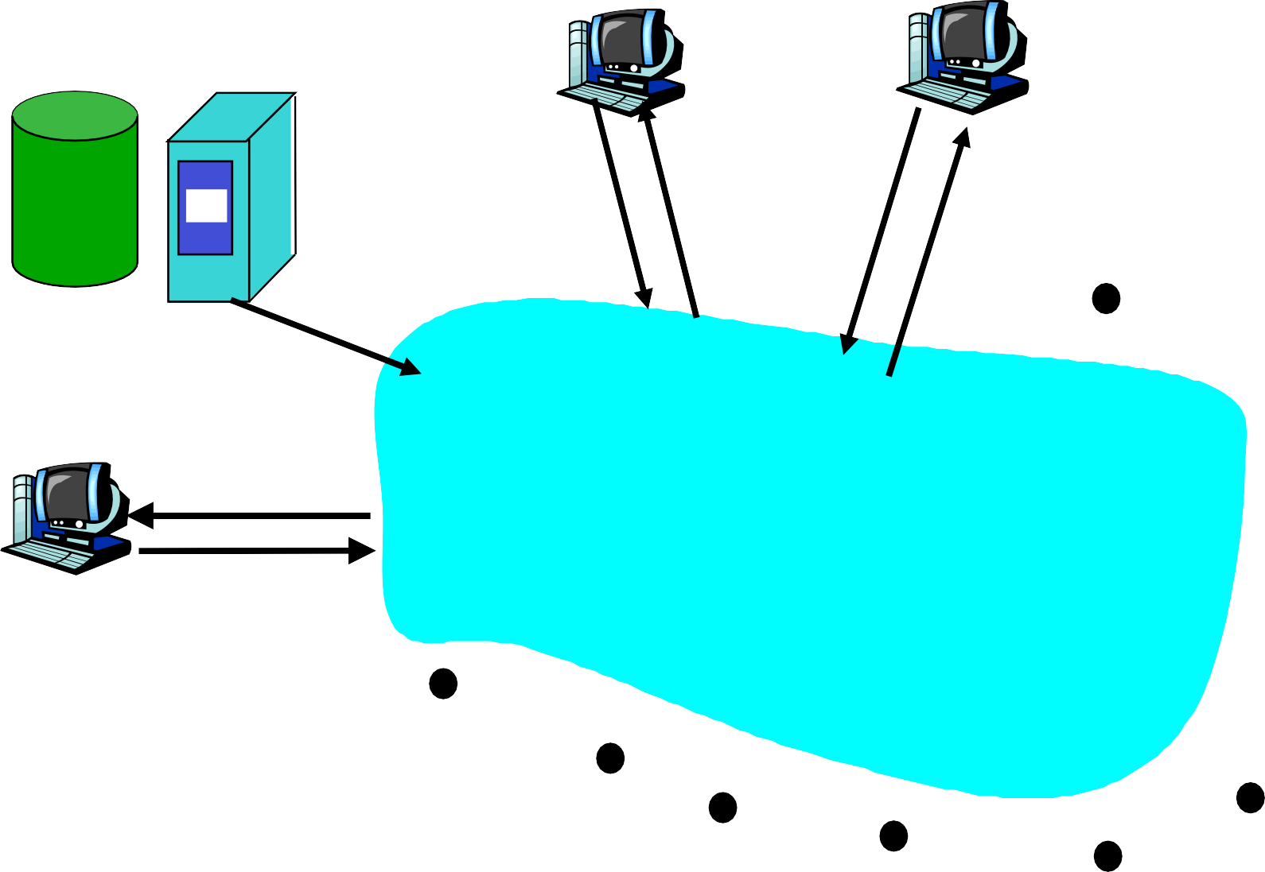


File Distribution: Server-Client vs P2P
Question : How much time to distribute file of size F from one server to N peers?
u_{s}: server upload
bandwidth
u_{i}: peer i upload bandwidth
Server
u₁ d₁
u₂
u_{s}
d₂
d : peer i download
i
bandwidth
File, size F
d_{N}
Network (with abundant bandwidth)
u_{N}
Application 2-77

Slide 97
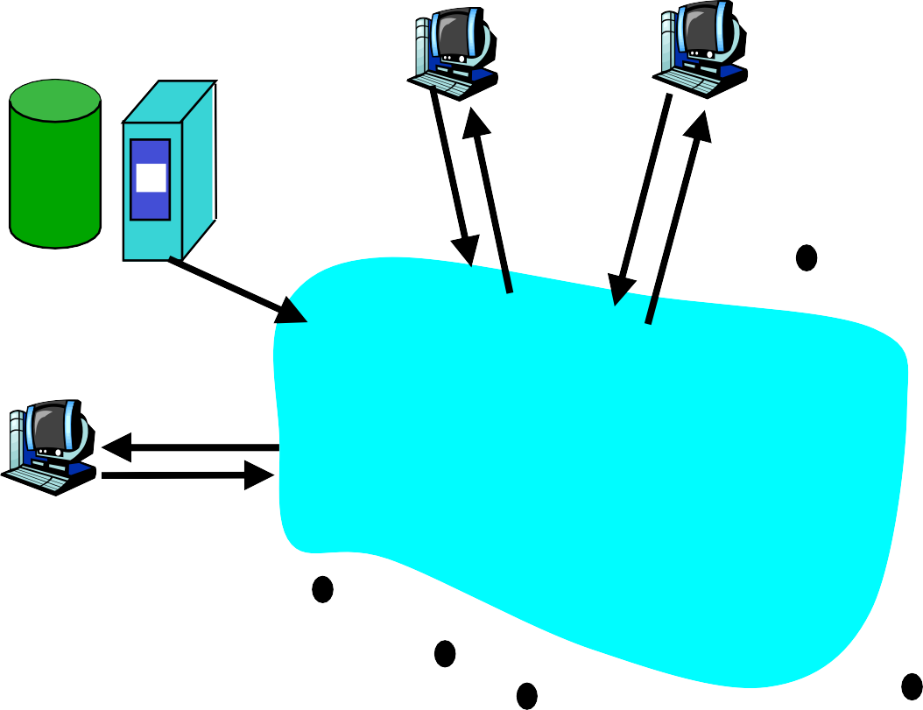
File distribution time: server-client
 server sequentially
sends N copies:
Server
F
u₁ d₁
u₂
 NF/us time
d
 client i takes F/d_{i} time to download
u_{s}
2
d
Network (with abundant bandwidth)
N
u
N
Application 2-78

Slide 98
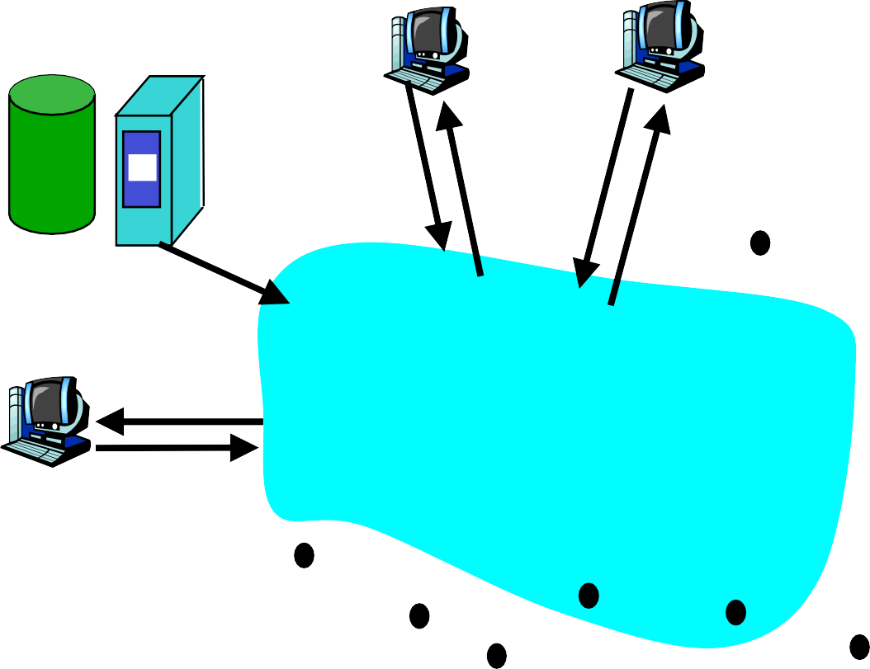
File distribution time: server-client
 server sequentially sends N copies:
Server
F
u₁ d₁
u₂
 NF/u time
d
s
 client i takes F/d_{i} time to download
u_{s}
2
d
Network (with abundant bandwidth)
N
u
N
Time to distribute F to N clients using client/server approach
= d = max { NF/u_{s}, F/min(d_{i}) }
cs
Application 2-78

Slide 99
File distribution time: server-client
 server sequentially sends N copies:
Server
F
u₁ d₁
u₂
 NF/u time
d
s
 client i takes F/d_{i} time to download
u_{s}
2
d
Network (with abundant bandwidth)
N
u
N
Time to distribute F to N clients using client/server approach
= d = max { NF/u_{s}, F/min(d_{i}) }
increases linearly in N (for large N)
cs
Application 2-78

Slide 100
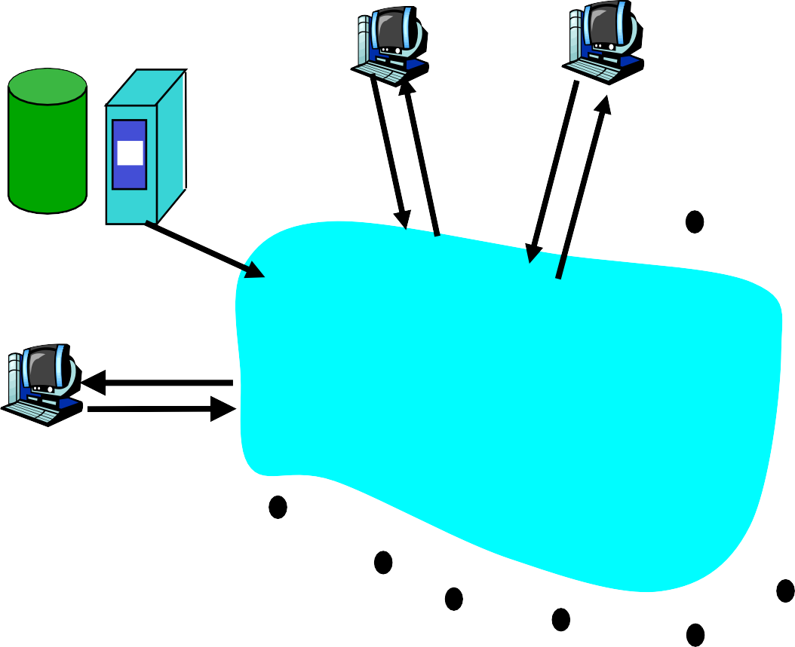
File distribution time: P2P
Server
server must send one copy: F/u_{s} time
client i takes F/d_{i} time to download
NF bits must be downloaded (aggregate)
F
u₁ d₁
u
2
u_{s}
d
2
d_{N}
u_{N}
Network (with abundant bandwidth)
 fastest possible upload rate: u_{s} + Σu_{i}
Application 2-79

Slide 101
File distribution time: P2P
Server
server must send one copy: F/u_{s} time
client i takes F/d_{i} time to download
NF bits must be downloaded (aggregate)
F
u₁ d₁
u
2
u_{s}
d
2
d_{N}
u_{N}
Network (with abundant bandwidth)
 fastest possible upload rate: u_{s} + Σu_{i}
d_{P2P} = max { F/u_{s}, F/min(d_{i}) , NF/(u_{s} + Σu_{i}) }
Application 2-79

Slide 102
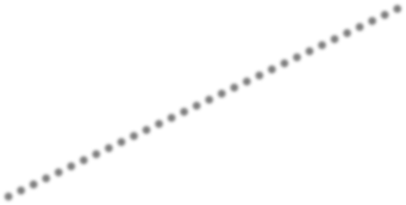

Server-client vs. P2P: example
Client upload rate = u, F/u = 1 hour, u_{s} = 10u, d_{min} ≥ u_{s}
5.00
P2P
Client-Server
Minimum Distribution Time
3.75
2.50
1.25
0.00
0
5
10
15
20
25
30
35
N
Application 2-80

